Slide 1

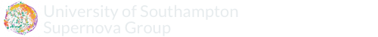


CoCo – Spectrophotometric Templates of Stripped Envelope Core Collapse Supernovae
Rob Firth
R.Firth@soton.ac.uk
Natasha Karpenka, Mark Sullivan, Szymon Prajs, Mat Smith
University of Southampton Supernova Group
supernova.soton.ac.uk
@UoS_SNe / @astro_berto
UoS-SNe

Slide 2
CoCo – Spectrophotometric Templates of Stripped Envelope Core Collapse Supernovae
Rob Firth
R.Firth@soton.ac.uk
Natasha Karpenka, Mark Sullivan, Szymon Prajs, Mat Smith
University of Southampton Supernova Group
supernova.soton.ac.uk
@UoS_SNe / @astro_berto
UoS-SNe

Slide 3
Rationale
Stripped Envelope SNe (SESNe):
SNe Ib, IIb, Ic, broad line (BL)-Ic
Existing stripped envelope SNe template sets
Small number of objects
Variable data quality
Important for Classification and Simulation
Recent releases have made more data available
Notes:
Quick summary of what I mean by Stripped Envelope SNe (SESNe):
SNe Ib, IIb, Ic, broad line (BL)-Ic
Existing stripped envelope SNe template sets have:
Only a Small number of objects
Variable data qualityImportant for Classification and Simulation
Important for Classification and Simulation
Recent releases have made more data available

Slide 4
Methods
Unlike (relative) homogeneity of (normal) SNe Ia, CC SNe show great heterogeneity in:
Absolute Luminosity
Spectral Evolution
Light Curve Morphology
‘SNe Ia’-like method impractical
Notes:
Unlike (relative) homogeneity of (normal) SNe Ia, CC SNe show great heterogeneity in:
Absolute Luminosity
Spectral Evolution
Light Curve Morphology
‘SNe Ia’-like method impractical

Slide 5
Methods
Approach used with SNe Ia:
Create mean spectrum at a given epoch from large number of SNe
Time series typically daily cadence
Additional sampling using linear interpolation
Aligned to common phase (typically B-band max)
Notes:
Approach used with SNe Ia:
Create mean spectrum at a given epoch from large number of SNe
Time series typically daily cadence
Additional sampling using linear interpolation
Aligned to common phase (typically B-band max)

Slide 6
Approach
Assemble sample of SESNe – Spectra and Photometry
Fit light curves SN-by-SN, filter-by-filter
Mangle spectra (see eg. Hsiao et. al. 2007, Conley et. al. 2008)
Spline order is N_{filters}+2
Correct for MW extinction
Use adjusted spectra to generate spectrophotometry
Fit this synthetic data with LC function to cover all epochs
Preserve (normalised) z=0 template and mangling function
Use Luminosity Function to generate LCs currently Li et. al. 2011
Notes:
Assemble as large as possible sample of well observed SESNe – Spectra and Photometry
- Remove host galaxy features
For each individual SNe, fit light curve filter-by-filter
Mangle spectra to match observed colours (see eg. Hsiao et. al. 2007, Conley et. al. 2008)
Spline order is N_{filters}+2
Correct for MW extinction
Use adjusted spectra to generate spectrophotometry
Fit this synthetic data with LC function to cover all epochs
Preserve normalised z=0 template and mangling function for use at any redshift, and for uncertainty propagation

Slide 7
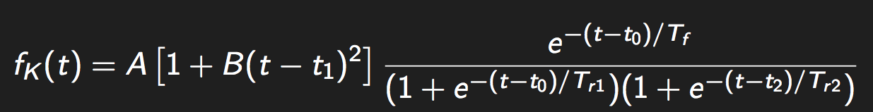
Functional Form
Flux in a given band ‘k’ at time t
Normalisation, rise time, fall time
Similar parameterisation to that used
Bazin et. al. 2009,
Karpenka, Feroz & Hobson 2013
Notes:
Flux in a given band ‘k’ at time t
Normalisation, rise time, fall time
Similar parameterisation to that used in,. For example
Bazin et. al. 2009,
Karpenka, Feroz & Hobson 2013

Slide 8
Data Sample
29 Stripped Envelope SNe, split into:
12 SNe Ib
9 SNe Ic
6 SNe IIb
2 SNe with intermediate classifications (Ib/c & II/Ib)
9 ≤ N(spectra) ≤ 59
17/29 use data from the CfA sample (Modjaz et. al. 2014, Bianco et. al. 2014)
Notes:
29 Stripped Envelope SNe, split into:
12 SNe Ib
9 SNe Ic
6 SNe IIb
2 SNe with intermediate classifications (Ib/c & II/Ib)
9 ≤ N(spectra) ≤ 59
17/29 use data from the CfA sample (Modjaz et. al. 2014, Bianco et. al. 2014)

Slide 9
Data Sample
Selection cuts:
SN must have observations in Bessel V
And at least one other band , in order to mangle spectra
N_{spectra} > 6
At least one before V band max
One within 2 days of peak
N_{phot}(per band) > 9 (at τ < 50)
Notes:
Selection cuts:
SN must have observations in Bessel V – define maximum light in V band
And at least one other band , in order to mangle spectra
N_{spectra} > 6
At least one before V band max
One within 2 days of peak
N_{phot}(per band) > 9 (at τ < 50)

Slide 10
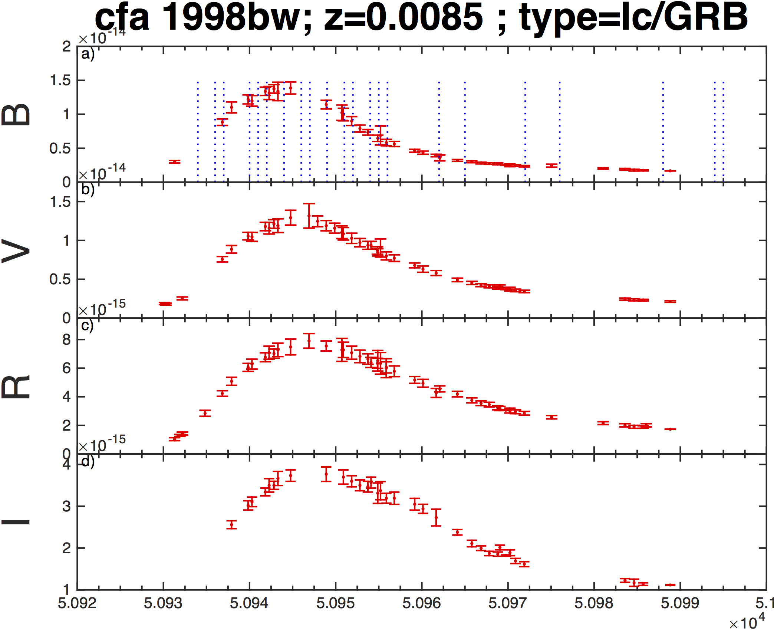
Example: SN1998bw
CfA sample object
Broad lined Ic
BVRI (other bands also)
Phase of Spectra shown in blue (top panel)
Notes:
CfA sample object
Broad lined Ic
BVRI (other bands also)
- Avoiding using other data at the moment due to small spacing in effective wavelength – overlapping filters can be temperamental
Phase of Spectra shown in blue (top panel)

Slide 11
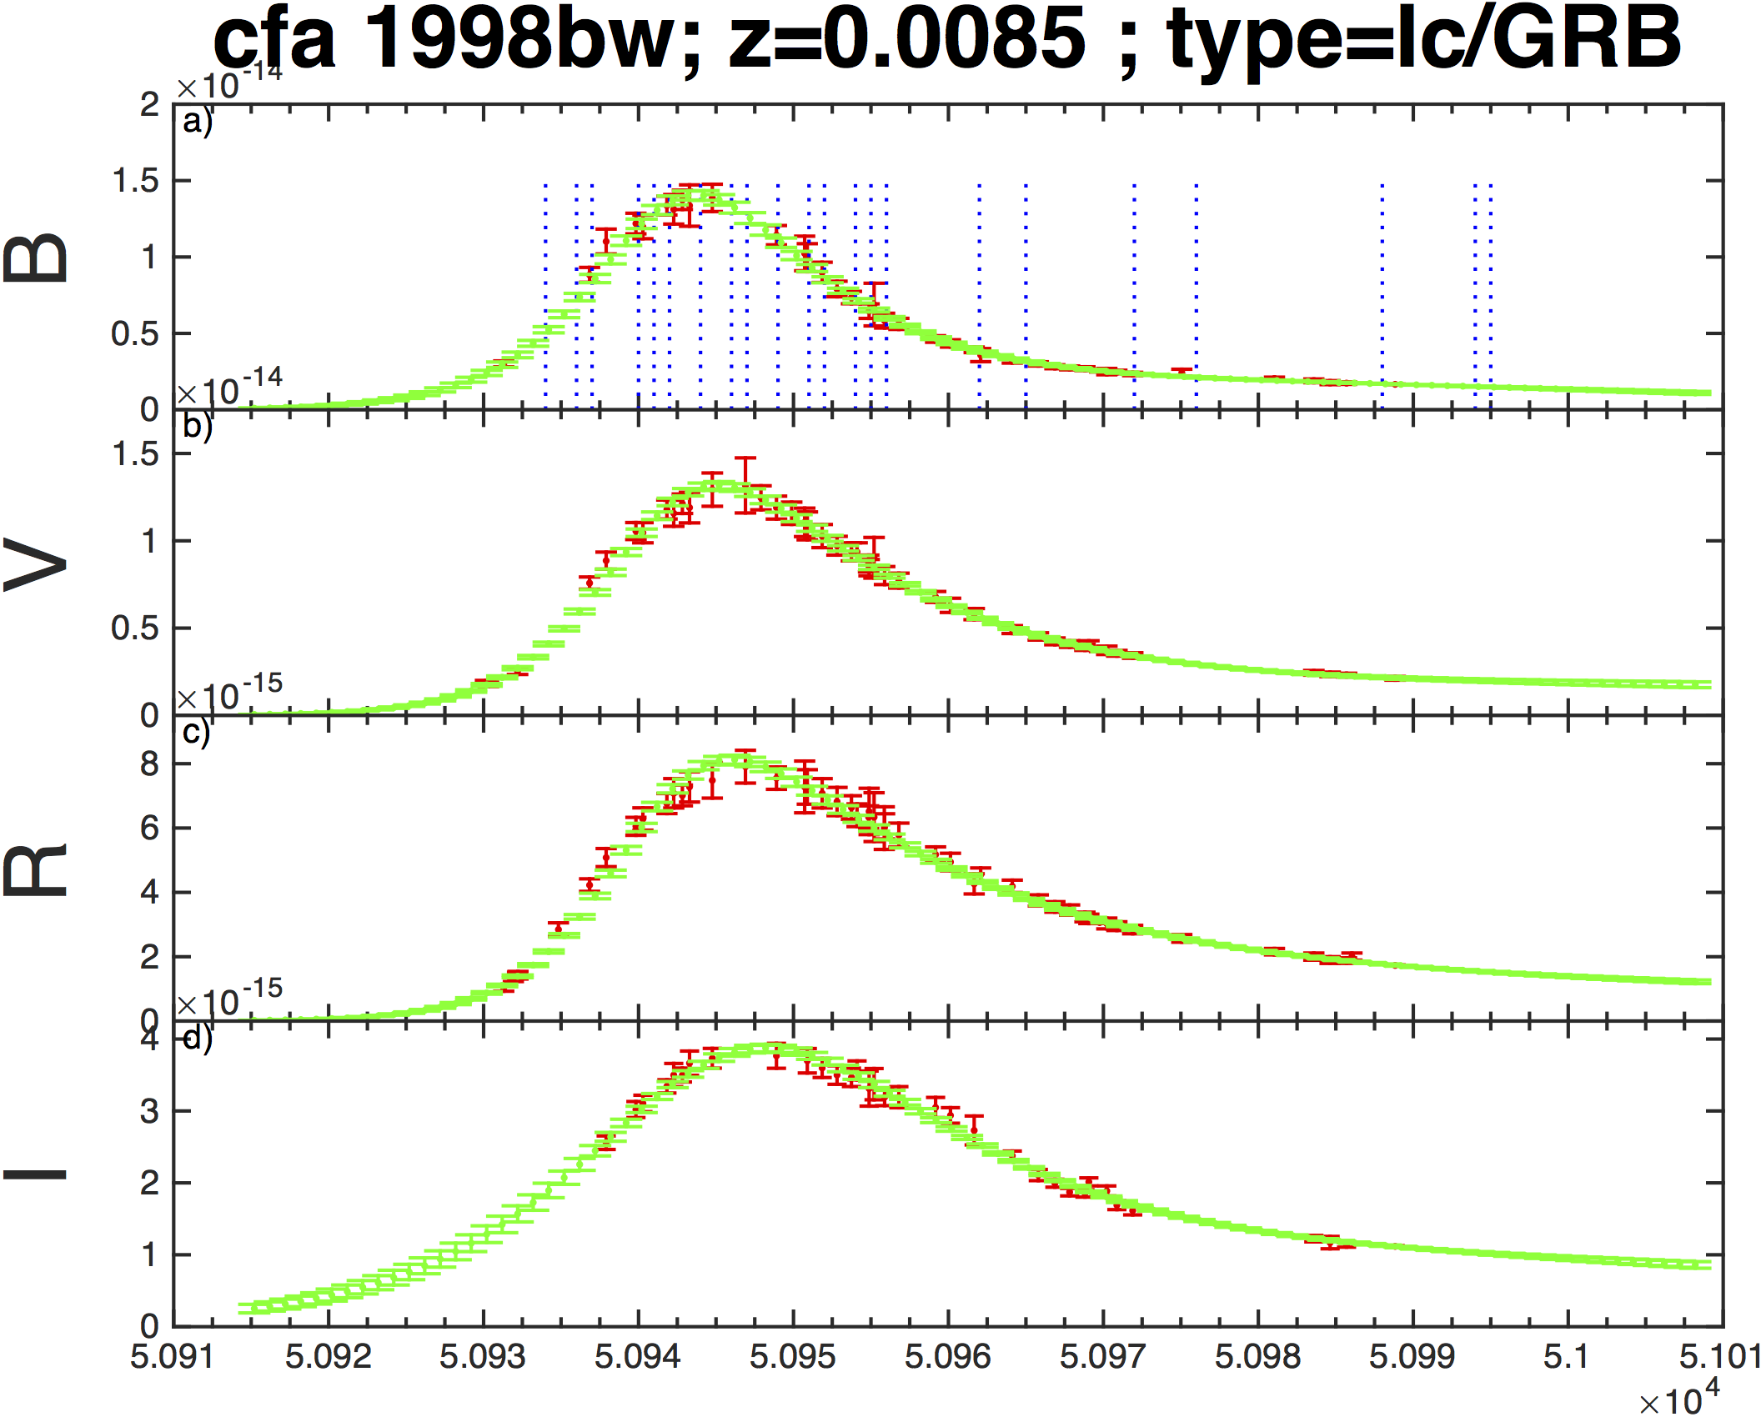
Example: SN1998bw
Fit shown in green
Uncertainties on fit propagated on through following steps
Good fit to the data
Notes:
Fit shown in green
Uncertainties on fit propagated on through following steps
Good fit to the data

Slide 12
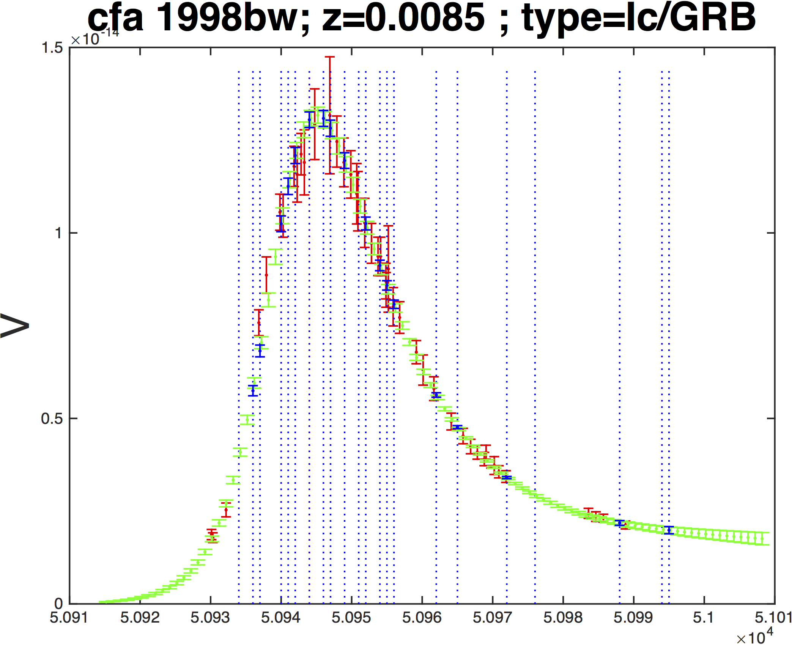
Example: SN1998bw – V Band
Fit (in green) to V-band photometry (in red)
Extract spectrophotometry and associated uncertainties (blue)
Note small size of uncertainties
Notes:
Concentrate on on and as an example.
Fit (in green) to V-band photometry (in red)
Extract spectrophotometry and associated uncertainties (blue)
Note small size of uncertainties

Slide 13
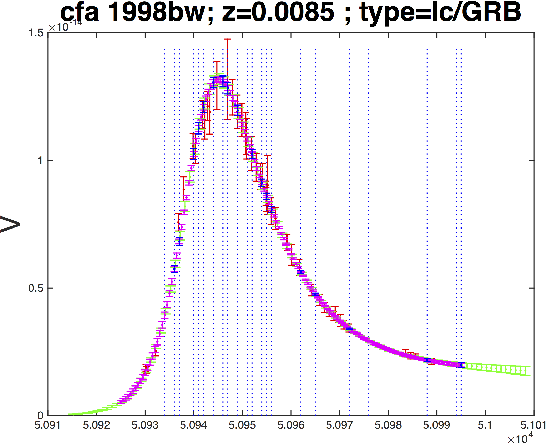
Example: SN1998bw – V Band
Consistency check – refit the new specphot
Refit is shown in purple – consistent with original (green) fit to photometry – as expected
Notes:
Consistency check – refit the new specphot
Refit is shown in purple – consistent with original (green) fit to photometry – as expected

Slide 14
Example: SN1998bw – V Band
Once the spectra have been calibrated and mangled, light curves can be generated for other bands at other redshifts.
Max redshift typically depends on the how blue the spectral series goes
Consistency check – refit the new specphot
Refit is shown in purple – consistent with original (green) fit to photometry – as expected
Notes:
Once the spectra have been calibrated and mangled, light curves can be generated for other bands at other redshifts.
Max redshift typically depends on the how blue the spectral series goes
- Need more UV data.
- Either (very) low-z UV, or NUV Blue Optical spectra of higher redshift Objects

Slide 15
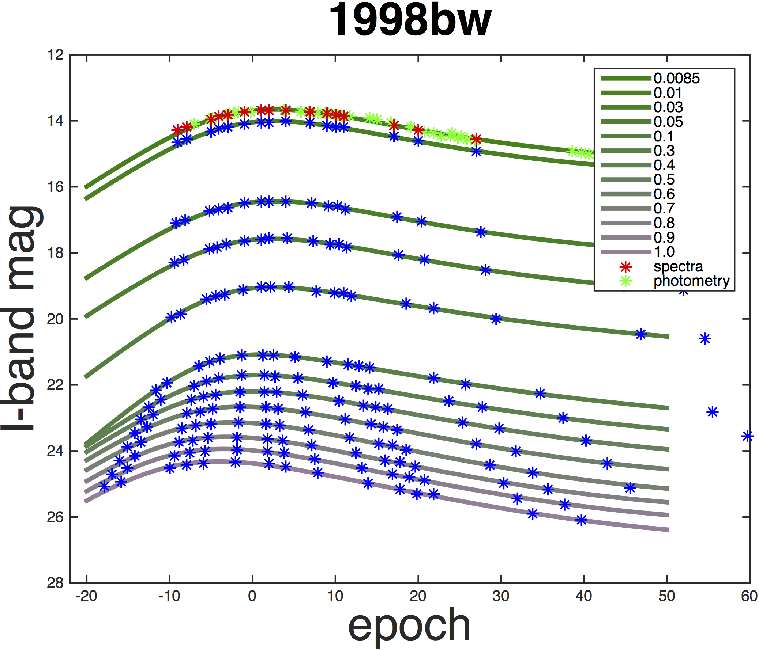
Usage - Simulation
Low-z
Can take SN1998bw to z≈1.0 in I-band
Only get to z≈0.1 in B-band
Need more UV data!
high-z
Notes:
Can take SN1998bw to z≈1.0 in I-band
Doesn’t have to be the same absmag, can choose from a lumdist

Slide 16
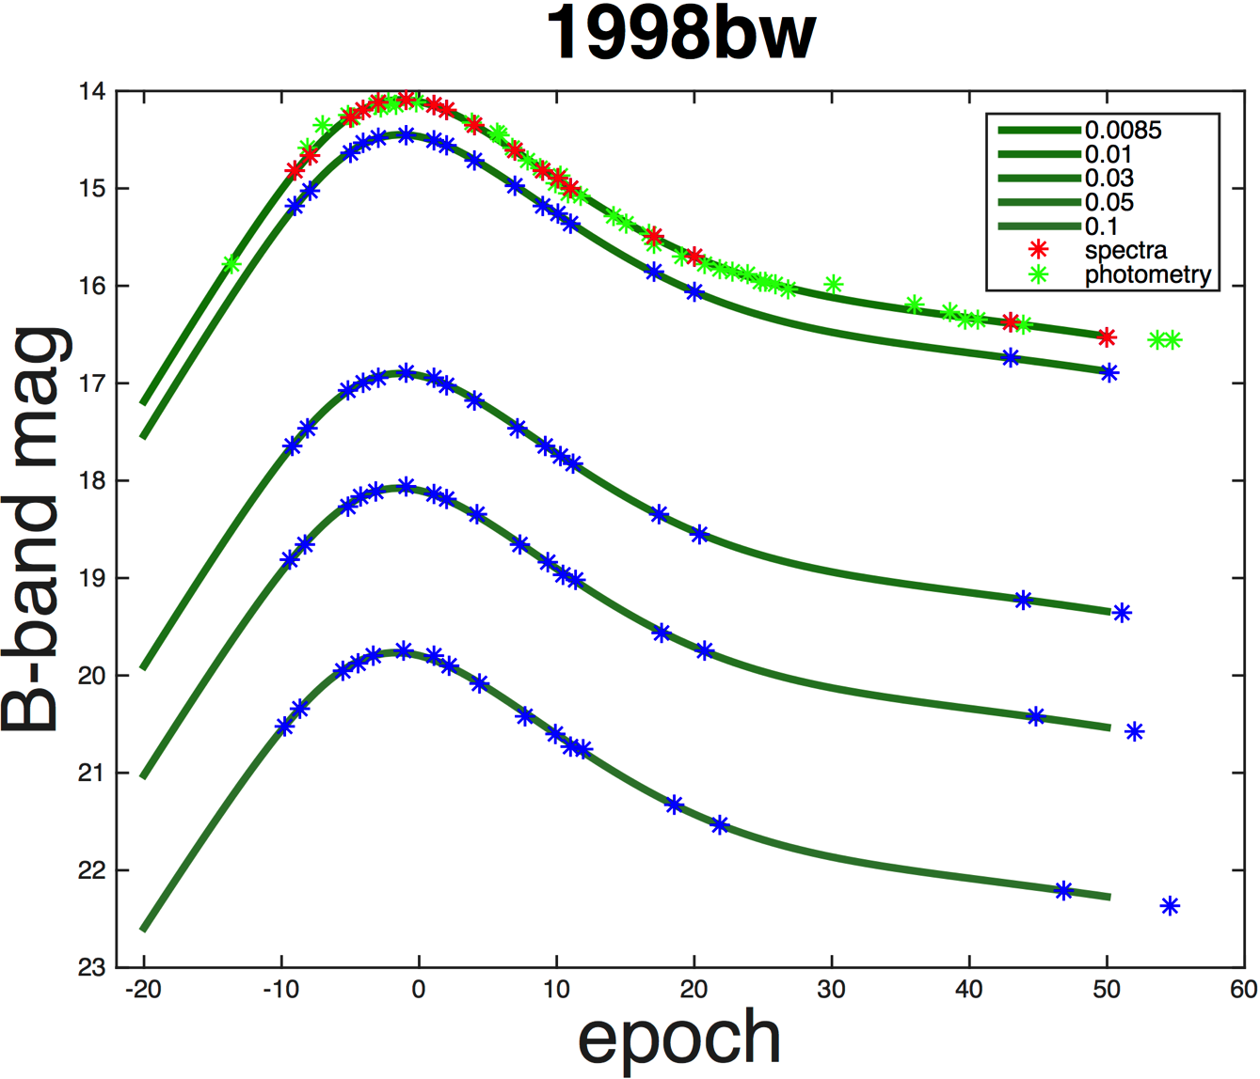
Usage - Simulation
Low-z
Can take SN1998bw to z≈1.0 in I-band
Only get to z≈0.1 in B-band
Need more UV data!
high-z
Notes:
Only get to z≈0.1 in B-band
Need more UV data!

Slide 17
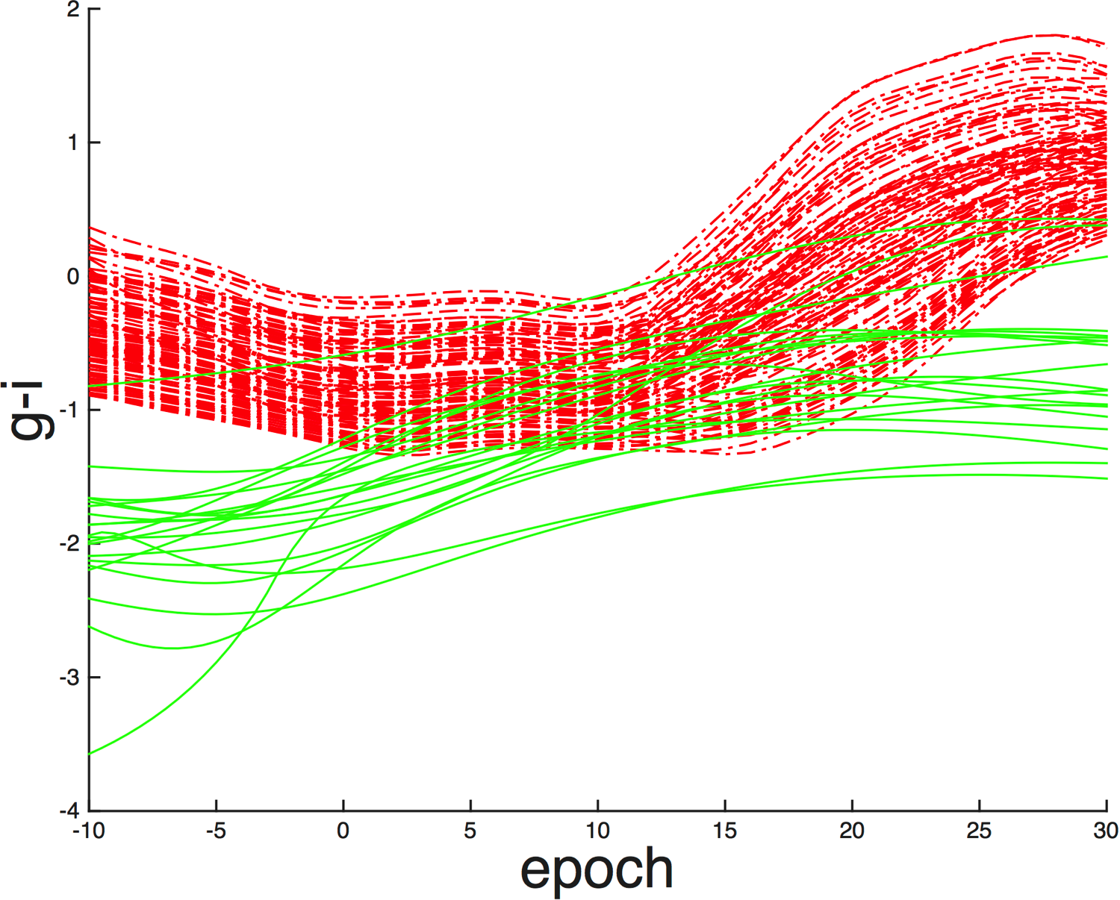
Usage – (Observed) Colour Evolution
Use colour to discriminate between types.
SALT2 SNe Ia templates shown in red.
CC SESNe shown in green
z=0.001
Notes:
Use colour to discriminate between types.
SALT2 SNe Ia templates shown in red.
CC SESNe shown in green

Slide 18
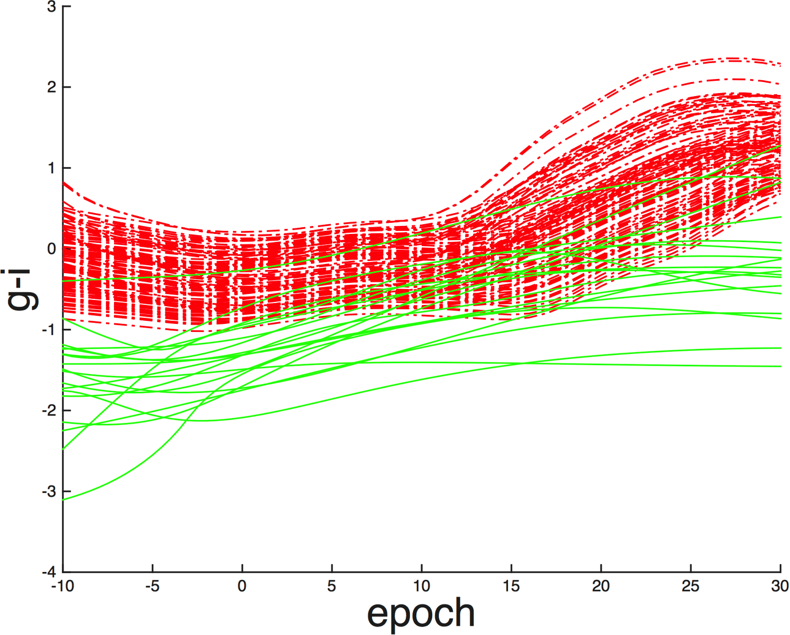
Usage – (Observed) Colour Evolution
Use colour to discriminate between types.
SALT2 SNe Ia templates shown in red.
CC SESNe shown in green
z=0.1

Slide 19
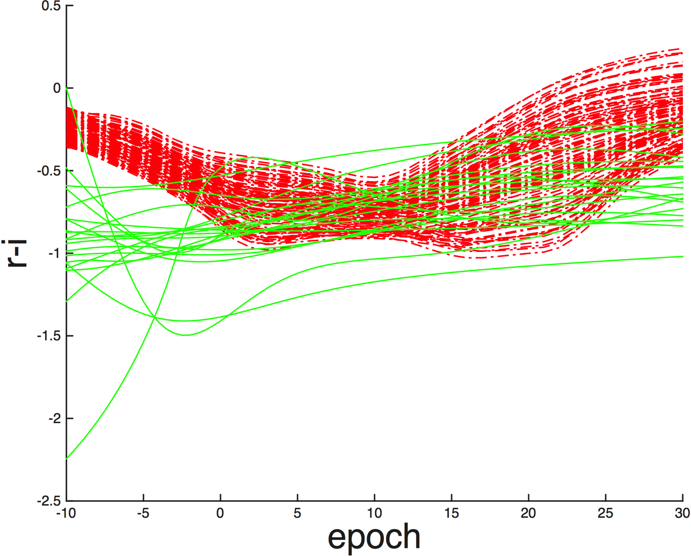
Usage – (Observed) Colour Evolution
Use colour to discriminate between types.
SALT2 SNe Ia templates shown in red.
CC SESNe shown in green
z=0.001
Notes:
Use colour to discriminate between types.
SALT2 SNe Ia templates shown in red.
CC SESNe shown in green

Slide 20
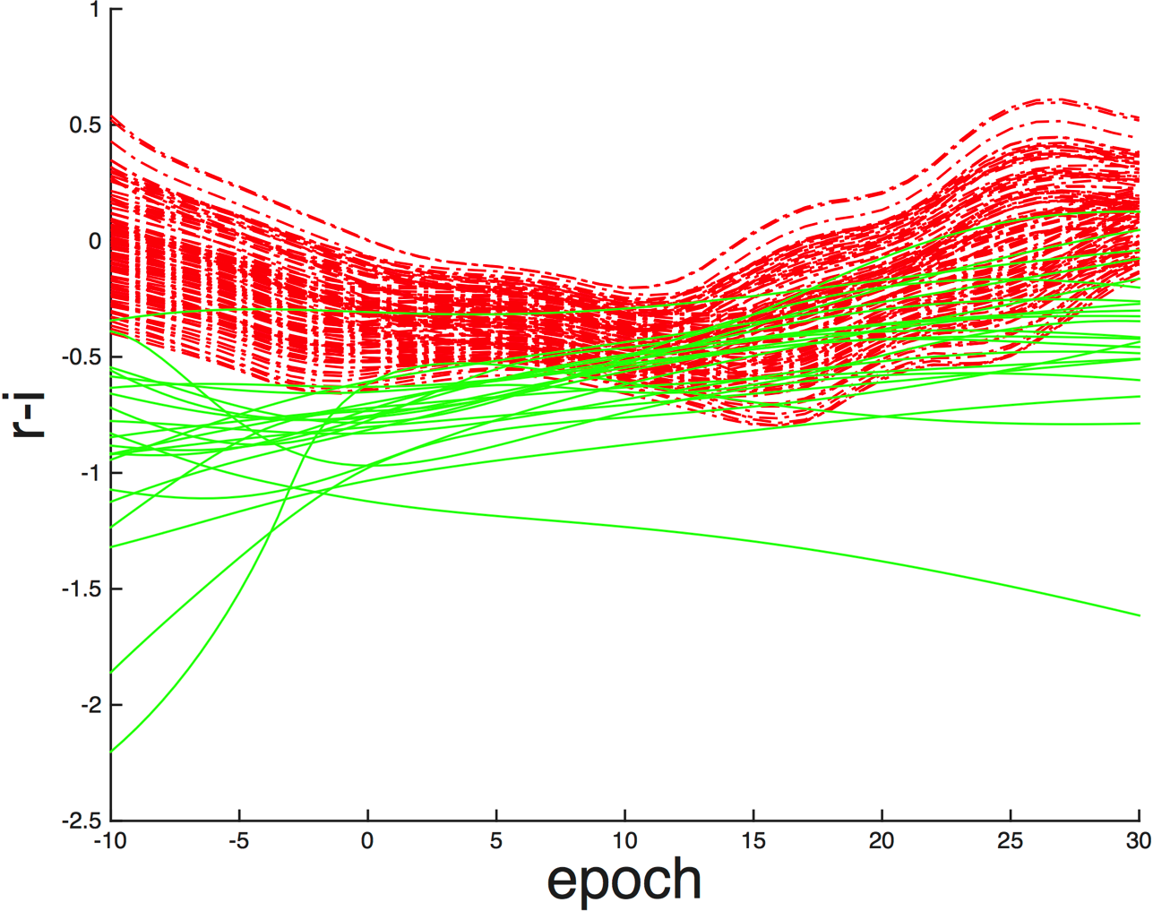
Usage – (Observed) Colour Evolution
Use colour to discriminate between types.
SALT2 SNe Ia templates shown in red.
CC SESNe shown in green
z=0.1
Notes:
Use colour to discriminate between types.
SALT2 SNe Ia templates shown in red.
CC SESNe shown in green

Slide 21
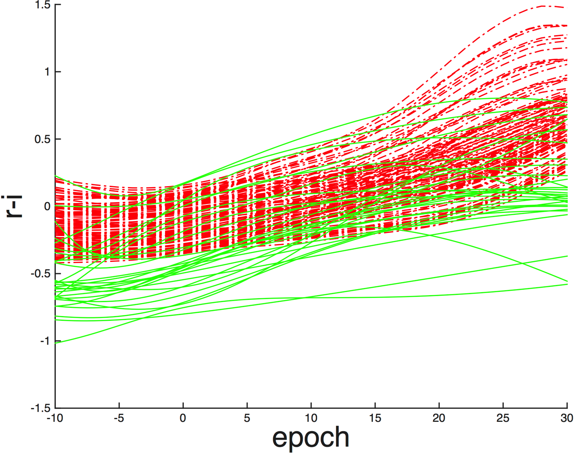
Usage – (Observed) Colour Evolution
Use colour to discriminate between types.
SALT2 SNe Ia templates shown in red.
CC SESNe shown in green
z=0.4
Notes:
Use colour to discriminate between types.
SALT2 SNe Ia templates shown in red.
CC SESNe shown in green

Slide 22
In Summary…
Github:
github.com/SzymonPrajs/CoCo
Development is active and ongoing!
Looking for volunteers
Priorities:
Speed – Currently slow, implement faster operation
Flexibility – add more templates
Python frontend
UV data
Luminosity Functions
Notes:
Github:
github.com/SzymonPrajs/CoCo – it will be moved soon – Keep an eye on Slack!
Development is active and ongoing!
Looking for volunteers
Priorities:
Speed – Currently slow, implement faster operation
Flexibility – add more templates
Python frontend, currently C – lots of the current development
UV data – Observe SESNe at higher redshift in Opt, or UV locally
Luminosity Functions

Slide 23
In Summary…
Light curve Fitter coupled with mangling of spectra = spectrophotometric data at any redshift
No need for k-correction
Full uncertainty propagation
Refit provides smooth LC template
29 SNe
Good for ‘one off objects’
Paper in prep
What does the community want in terms of output/end product?
How to best apply and integrate?

Slide 24
Questions?

